Slide 1
An Introduction to
Reinforcement Learning
By Christopher Torrington

Slide 2
Markov Decision Process

Slide 3
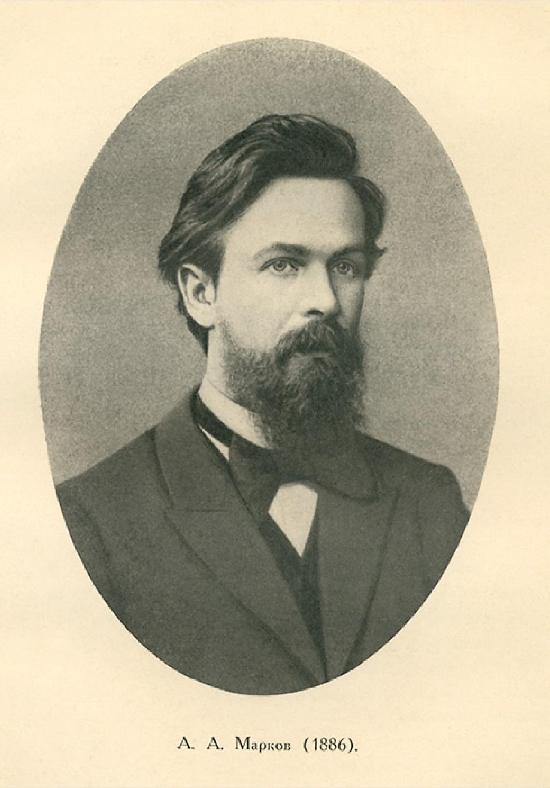
Andrey Markov
Notes:
The name of MDPs comes from the Russian mathematician Andrey Markov as they are an extension of Markov chains.

Slide 4
Main
Space
Academy Room

